Slide 1
Beyza Döger 1700002939
Ezgi Özarın 1700002653
Seray Vatan 1700003609
Ata Can Kara 1700002737
Aleyna Kaya 1700003936

Slide 2


VISION
Respectful to himself and his environment. to be a pioneer in the creation of individuals with advanced environmental awareness and morality and to raise individuals who will carry the republic forward.
MISSION
To raise healthy children under the roof of the school and to be a guiding institution for families by combining the concepts of school - family - environmental awareness - responsible.

Slide 3
EFE MATRIX
Opportunities | Weight | Rating | Weighted Score
Increasing need for kindergarten due to increasing working population. | 0.05 | 1 | 0.02
People living in the location of the kindergarten are mostly young and working people, so they need a school for their children | 0.15 | 3 | 0.52
there are quite a lot of work places around our kindergarten parents feel close to their children and can control them | 0,08 | 2 | 0.12

Slide 4
EFE MATRIX
Threats | Weight | Rating | Weighted Score
There are other kindergartens in the region that provide education other than us. | 0,15 | 1 | 0.12
Increasing school fees due to rising inflation. | 0,10 | 2 | 0.25
Parents not wanting to send their children to school due to the pandemic | 0,06 | 2 | 0.13

Slide 5
IFE MATRIX
Strengths | Weight | Rating | Weighted Score
Our native English-speaking teachers and highly educated teaching staff | 0.20 | 2 | 0.57
Strong and experienced management staff | 0.15 | 1 | 0.26
Have a strong capital | 0.17 | 2 | 0.32
Have a variety of teaching materials | 0.13 | 2 | 0.25

Slide 6
Weaknesses | Weight | Rating | Weighted Score
Competition based on prices | 0.15 | 2 | 0.27
Failure to make much profit from school fees. | 0.08 | 1 | 0.13
Costs arising from our teachers' high-salary work and fringe benefits | 0.12 | 3 | 0.17

Slide 7
Star
Products in high growth markets with high market share.
Can be the market leader though require ongoing investment to sustain. They generate more ROI than other product categories.
Monopolies and first-to-market products are frequently termed stars.

Slide 8
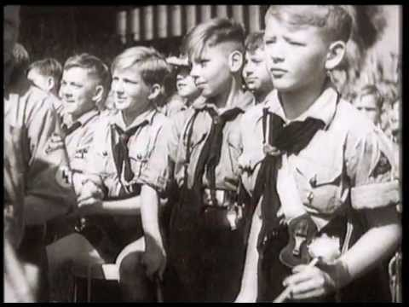
Star
Because of their high growth rate, stars consume large amounts of cash. This generally results in the same amount of money coming in that is going out.
Stars can eventually become cash cows if they sustain their success until a time when a high growth market slows down.
A key tenet of BCG strategy for growth is for companies to invest in stars.
Our kindergarten's components hold a high share in a high-growth market. Schools in this field need investment to maintain their position and differentiation in both mature and emerging markets. We also attach great importance to investment.

Slide 9
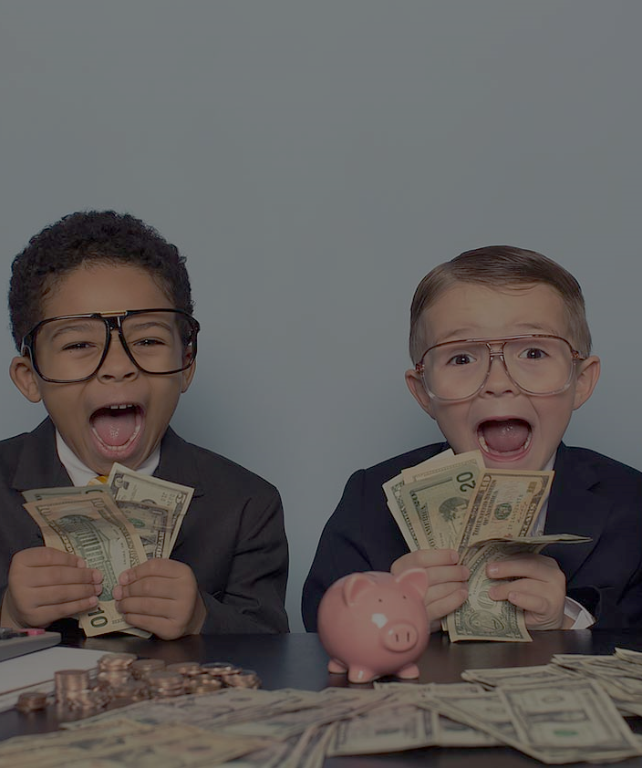
Cash Cows
These brands are important because of their cash-generating potential. This means they have a higher market share in a slow growing industry. Very little investment is required for these brands, and funds from them are used to feed the Stars or Question Marks.

Slide 10
Cash Cows
The cash cow is a market leader that generates more cash than it consumes. Cash cows are business units or products that have a high market share but have low growth prospects. According to NetMBA, cash cows provide the money needed to turn a question mark into a market leader, cover the company's administrative costs, fund research and development, cover corporate debt, and pay dividends to shareholders.

Slide 11
Cash Cows
Companies are advised to invest in cash cows to maintain their current level of productivity or passively "milk" earnings.

Slide 12
Dogs
The term of Dog may also refer to an underperforming stock in general, and thus a stock that affects the performance of a portfolio. Does not generate strong cash flow as cash cow.
In most cases, because a dog operates in a typically mature industry, management will not be justified in allocating more capital to it to expand its Sunday Share. A dog is a logical candidate for sale or disposal , as it connects valuable capital and resources that can be used more effectively elsewhere in the company.

Slide 13
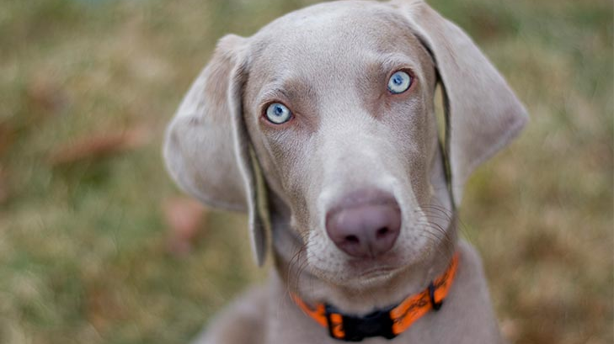
Dogs
As we are a newly established company, our future situation is uncertain. In the future, we can turn into a cash cow, or we can grow and become a star.
Due to the fact that there are so many schools in this sector, our brand is in the development stage and has a growth potential.

Slide 14
We attach great importance to marketing strategy. Advertising is very important to us. We want to be known more. Therefore, besides advertising on TV, we also take actions such as taking place on billboards and distributing brochures. We agreed with a PR agency.

Slide 15
Children who learn one or two foreign languages besides their mother tongue at an early age can switch from one language to another when necessary.From the age of two, a larger part of our brain is used for the newly learned.German language English is the most common language in the world, which is why we decided to give German language lessons in addition to English language lessons so that our children can develop more.

Slide 16

Our rules for our employees are as follows
Our teachers are obliged to greet the child who comes every morning and to see him in the evening.
Teachers must inform parents on a daily basis.
Parents of a child cannot leave school until they arrive.
Managers are responsible for the administration of the school. Every manager has a role.
No one can take the student out of school except his mother and father.

Slide 17

RESISTANCE TO CHANGE IN OUR EDUCATIONAL ORGANIZATION
As a school, we are an institution open to changes and innovations. We provide our students the only one international in innovation and education can not continue their education in Turkey. Therefore; we follow the agenda closely. We examine closely all areas such as technology, foreign language, education and we are open to innovation.
This Photo by Unknown Author is licensed under CC BY

Slide 18
RESISTANCE TO CHANGE IN OUR EDUCATIONAL ORGANIZATION
We are developing a different strategy to prevent change;
First, we ask the child's parent's thoughts and develop a change strategy by taking care of their ideas. And when we think of each child as a separate individual, we approach them all differently and adopt a reliable strategy principle that does not undermine their values and beliefs.
This Photo by Unknown Author is licensed under CC BY

Slide 19
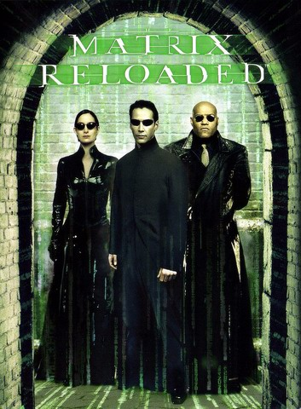
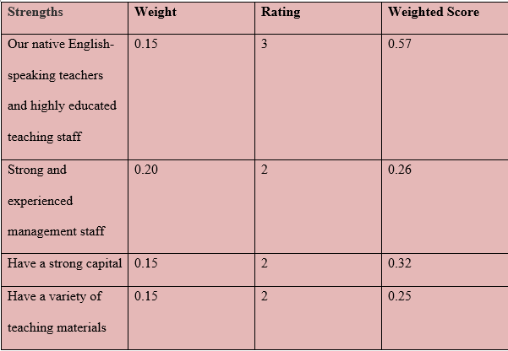
IFE MATRIX

Slide 20
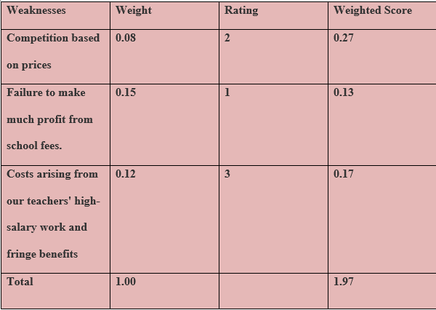
IFE MATRIX

Slide 21

First of all, we collect the weaknesses and strengths of our institution at every meeting. We especially emphasize the weaknesses.
Identify corporate opportunities and threats on the basis of stakeholder views.

Slide 22

Quality
Determine our mission, vision, core values and policies by constantly updating them.
Emphasize our core values and policies.
We also look at the simplicity of our goals and strategies, and their appropriateness to the fields of activity of other institutions..

Slide 23

Harmonizing educational standards and student assessment
Examine students' motivation, effort, learning styles and self-efficacy
Part of the strategy may include reliability, with a high degree of validity usability .

Slide 24
We have seen the efficiency of our students in harmony with our education.
Strategies to achieve this type of integration involve a closer interface between formative evaluation and summative evaluation.
Self-assessment is more of a tool more development management for challenging tasks making assumptions or conclusions threatening key actors at school hierarchy.

Slide 25

TEACHER EVALUATION
Improve the teacher's own practice by identifying strengths and weaknesses
More effective decisions about developmental needs and education.
The tendency to reveal weaker aspects of performance is reduced, ie the improvement function may be compromised.

Slide 26
Integrating Student Formative Assessment
Strategies to achieve such integration include a closer interface between formative evaluation and summary evaluation.
Another priority may be to strengthen potential of standardized assessments we officially used in the classroom.
More in general, it should be assumed that it is in distinction between two classes forms of evaluation are often blurry and it depends on each teacher's classroom practice.

Slide 27
Relating Causes of Project Failure to an Organizational Strategic Business Framework
Project initiation-related causes of failure 40%
Project mgt. operational-related causes of failure 30%
Organizational leadership-related causes of failure 15%
Project mgt. leadership-related causes of failure 9%
Other (externally-related) causes of failure 6%

Slide 28
Our 5-Years Strategic Planning​
2021
Increasing the support of the Pdr Department to the student and his family.
2022
Promoting all activities in English​.
2023
Reaching more students from different cultures.​
2024
2025
Increasing the number of foreign instructors.
Recognition and leadership in the Istanbul European side region.​
Increasing the number of our branches and students.
Improvement and development of Education and training staff.
Increase in school income level.​
Increasing teacher salaries.
Updating classrooms by following technologies and innovations​.

Slide 29
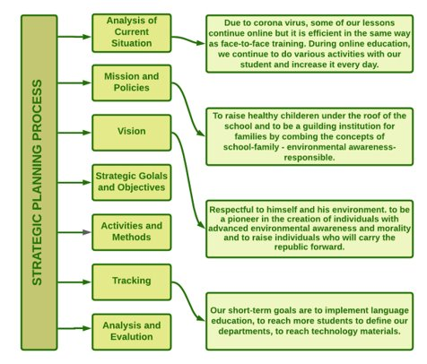

Strategic Planning Flow Chart Model

Slide 30
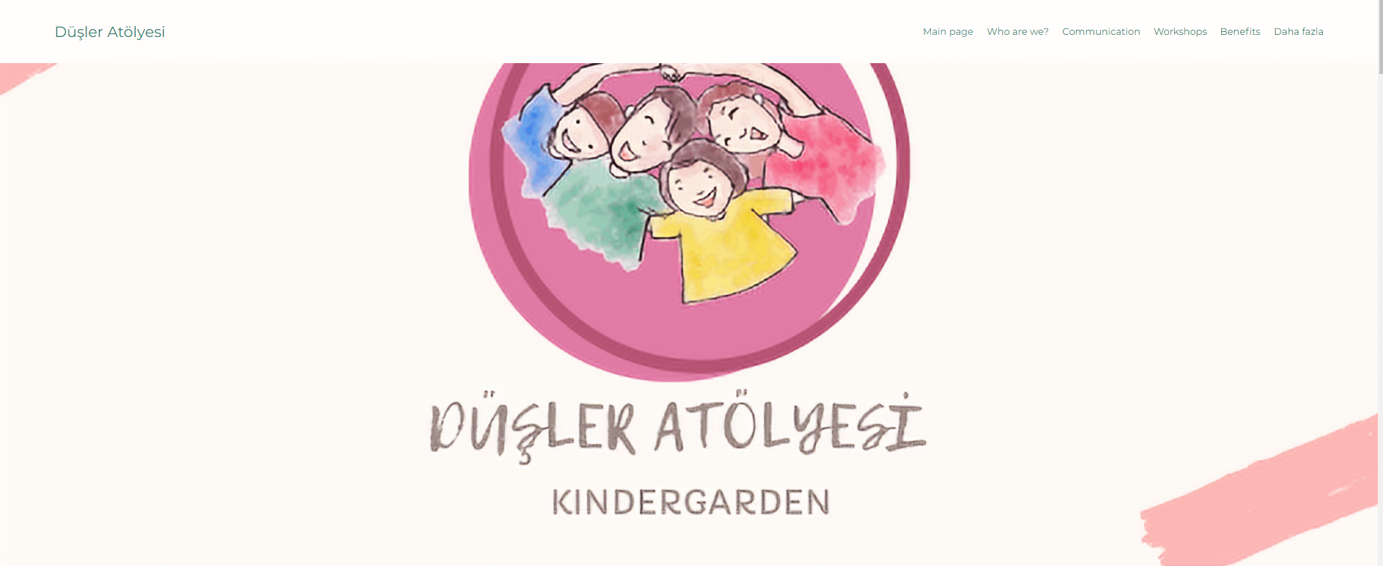
DüşLER ATOLYESi WEB Sıte
https://ack2012ack.wixsite.com/dusleratolyesi

